Slide 1
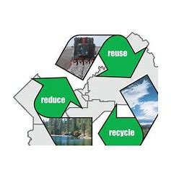
\* proposed display for the landing page*\
Welcome to…
swt
Solid Waste Token
farming
…help to keep the our environment clean and safe
Displayedstakingbalance
Stake
Unstake

Slide 2
Stake
\* proposed display when stake button is clicked from the landing page*\
Amount
Enter amount to stake
Available

Slide 3
\* proposed display when unstake button is clicked*\
Unstake
Confirmation
“Success”
or
“You have nothing to unstake”

Slide 4
/*Button connections
Amount */
UI | Solidity
Amount | _amount
Displayedbalance | stakingBalance
Stake | stakeToken()
Unstake | unstakeToken()

